Slide 1
SDLC process
Marlabs
Week 1

Slide 2
Table of Content
The Software Development Life Cycle
Agile Methodology
Scrum Methodology
DevOps Tools in Your Data Science Projects
E.g. Azure DevOps
Assignments

Slide 3
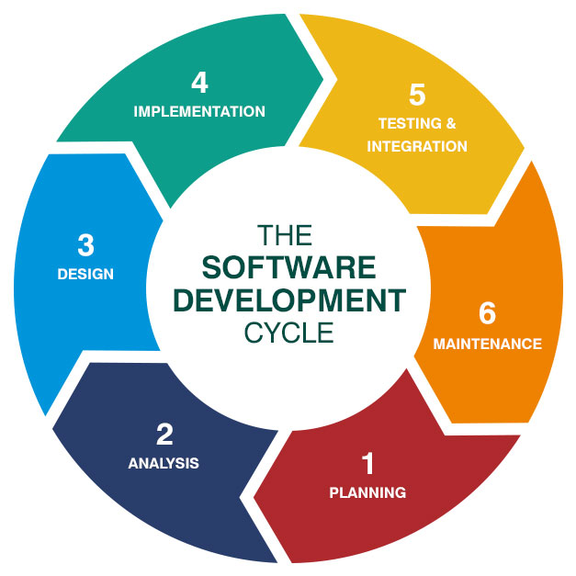
The Software Development Life Cycle (System Development Life Cycle)

Slide 4
SDLC
SDLC is a process followed for a software project, within a software organization.
It consists of a detailed plan describing how to develop, maintain, replace and alter or enhance specific software.
The life cycle defines a methodology for improving the quality of software and the overall development process.

Slide 5
1. Planning (Planning & Requirement)
Business Analyst collects the requirement from the Customer/Client as per the clients business needs and documents the requirements in the Business Requirement Specification (BRS) and provides the same to Development Team.

Slide 6
2. Analysis
Define and document the product requirements and get them approval from the customer.
Key people involved in this phase are:
Project Manager, Business Analyst and Senior members (Senior Data Scientist) in the team.

Slide 7
3. Design
”How will we get what we want?”
Turn the software specifications into a design plan called the Design Specification.
All stakeholders then review this plan and offer feedback and suggestions.

Slide 8
4. Implementation
Coding stage, or building stage.
Develop the software by generating all the actual code.

Slide 9
5. Testing & Integration
Test for defects and deficiencies.
Fix those issues until the product meets the original specifications.
Deployment.
Depending on feedback from end users, more adjustments can be made.

Slide 10
6. Maintenance
The plan almost never turns out perfect when it meets reality.
As conditions in the real world change, we need to update and advance the software to match.

Slide 11
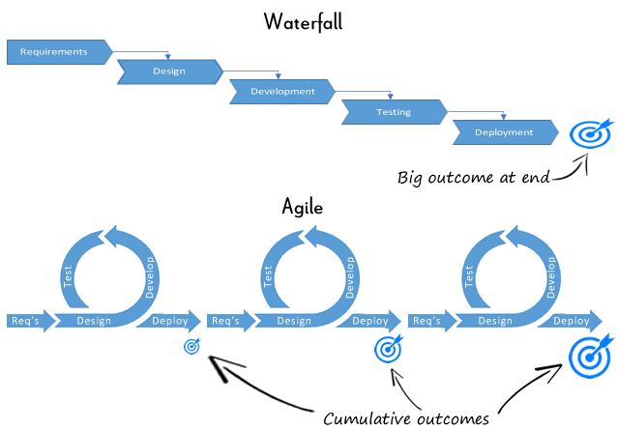
Agile Methodology
Agile is a method of project management.
Unlike Waterfall approach, where all the requirements are gathered at the beginning, then all the design is done next, and lastly the development part gets executed, the Agile approach allows business analysts, designers, developers, and the stakeholders to work together simultaneously.

Slide 12
Scrum Methodology
Scrum is a method of Agile project management.
Terms Explained:
Product Backlog: a list of all things that needs to be done within the project.
Sprint Backlog: a list of tasks identified by the Scrum team to be completed during the Scrum sprint.
Scrum Master: a servant-leader (facilitator) for the Scrum team.
Sprint: a set period of time during which specific work has to be completed and made ready for reviews

Slide 13
DevOps Tools in Your Data Science Projects

Slide 14
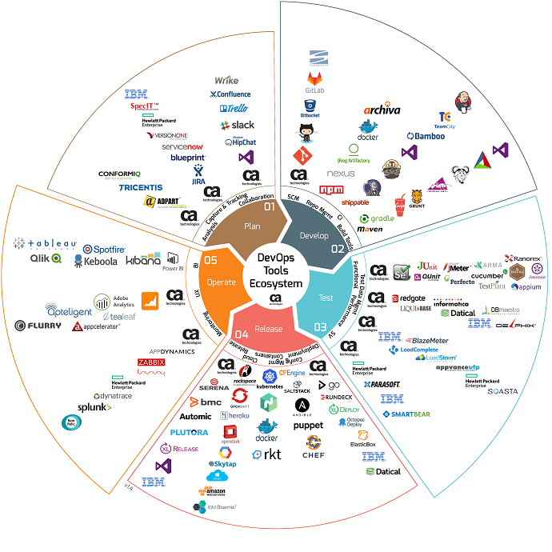

Slide 15
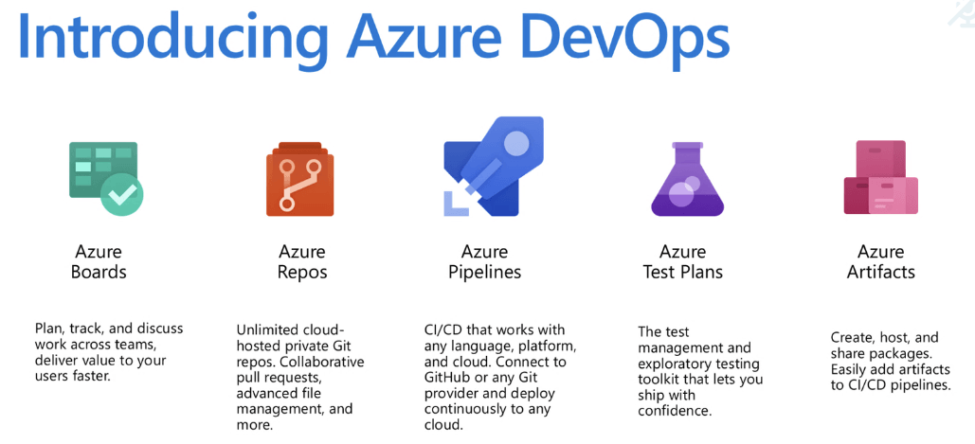
Azure DevOps
E.g.: https://dev.azure.com/dishaands

Slide 16
Assignments
Reading Assignments:
https://www.peerbits.com/blog/agile-software-development.html
http://www.mountaingoatsoftware.com/agile/scrum
Set up accounts:
GitHub Account
Kaggle Account

